Slide 1
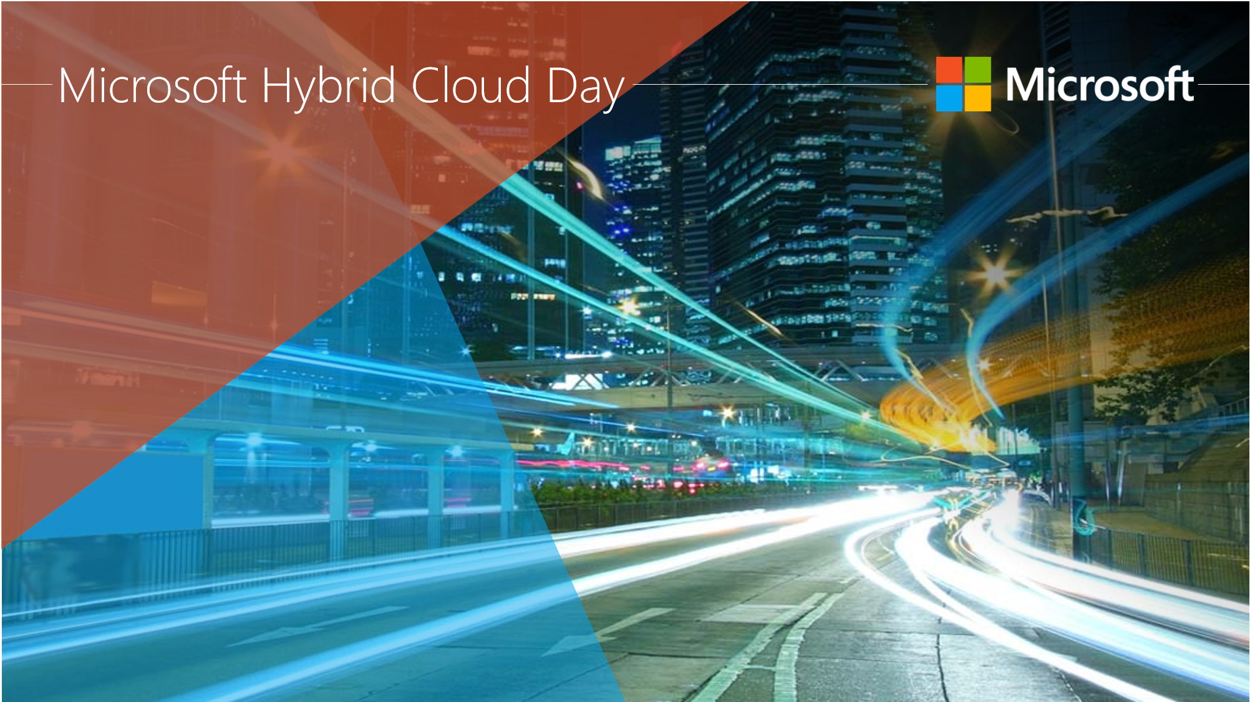
Security & Management - Examine Common Architectures for Hybrid Entity
Abdul Rasheed Feroz Khan
Microsoft MVP / Founder | CodeSizzler Technologies

Slide 2
Agenda
Design of Hybrid Identity Solution with AD
On-Premise Infrastructure Integration
User Accounts
Devices
Partner Collaboration
Customer Account Management
Application Integration
Administration
Business Requirements
Technical Requirements
Demo

Slide 3
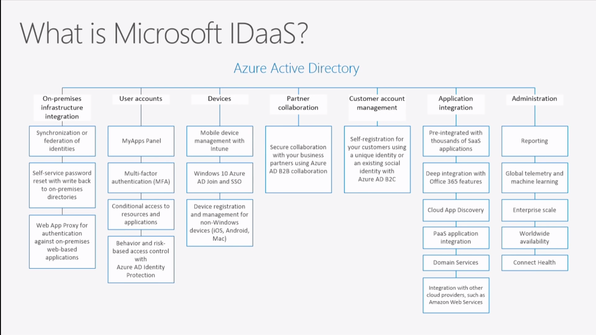

Slide 4
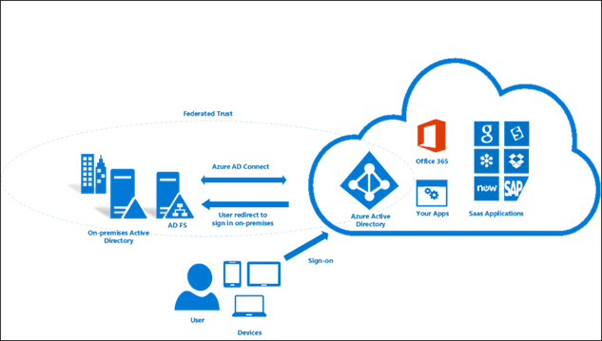
Business Requirements:
Determine the Business needs
Directory Synchronization
Multi – Factor Authentication
Hybrid Identity Adoption Strategy

Slide 5
Technical Requirements
How to protect the data?
Audit & Log for users
Single Sign – on
Massive authentication

Slide 6
Active Directory Integeration
Provide Single Sign – On
Same credentials for On-Premise and Azure Cloud
Simple Provisioning Process

Slide 7
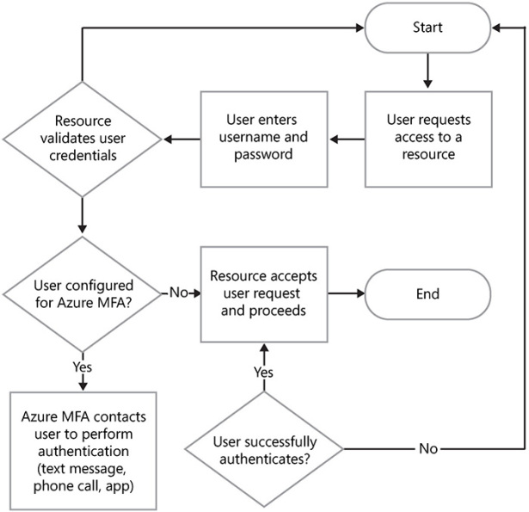
Azure Multi – Factor Authentication

Slide 8
User Self Service from the Azure Access Panel
Self Service task from the User’s Azure Access Panel
Self Service to update and verify their contact information
Self Service group management for cloud users

Slide 9
Demo –
Azure Multi Factor Authentication
Azure Access Panel

Slide 10
Thank You !
Email: feroz@codesizzler.com
Twitter: @TechFero

